Slide 1
VLDL Review

Slide 2
Major Lipoproteins
 | From | To | Apolipoproteins
Chylomicrons | Gut | Adipose/Muscle | AV, B48, CII, E
VLDL | Liver | Tissues | AV, B100, CII, CIII, E
IDL | Tissues | Liver (and to IDL) | B100, E
LDL | Tissues | Liver | B100, E
HDL | Tissues | Liver | AI, CII, E

Slide 3
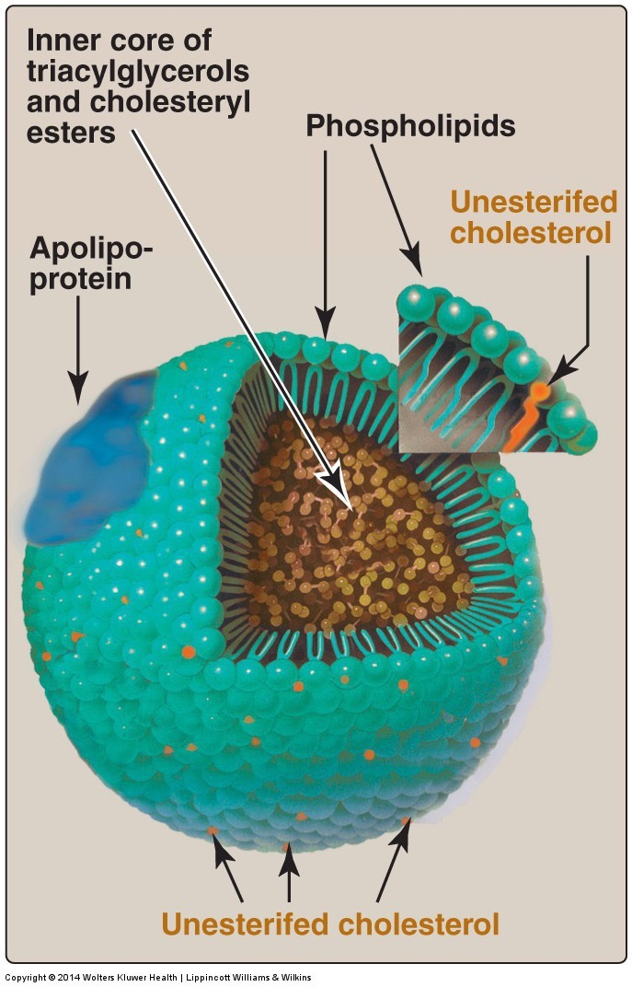
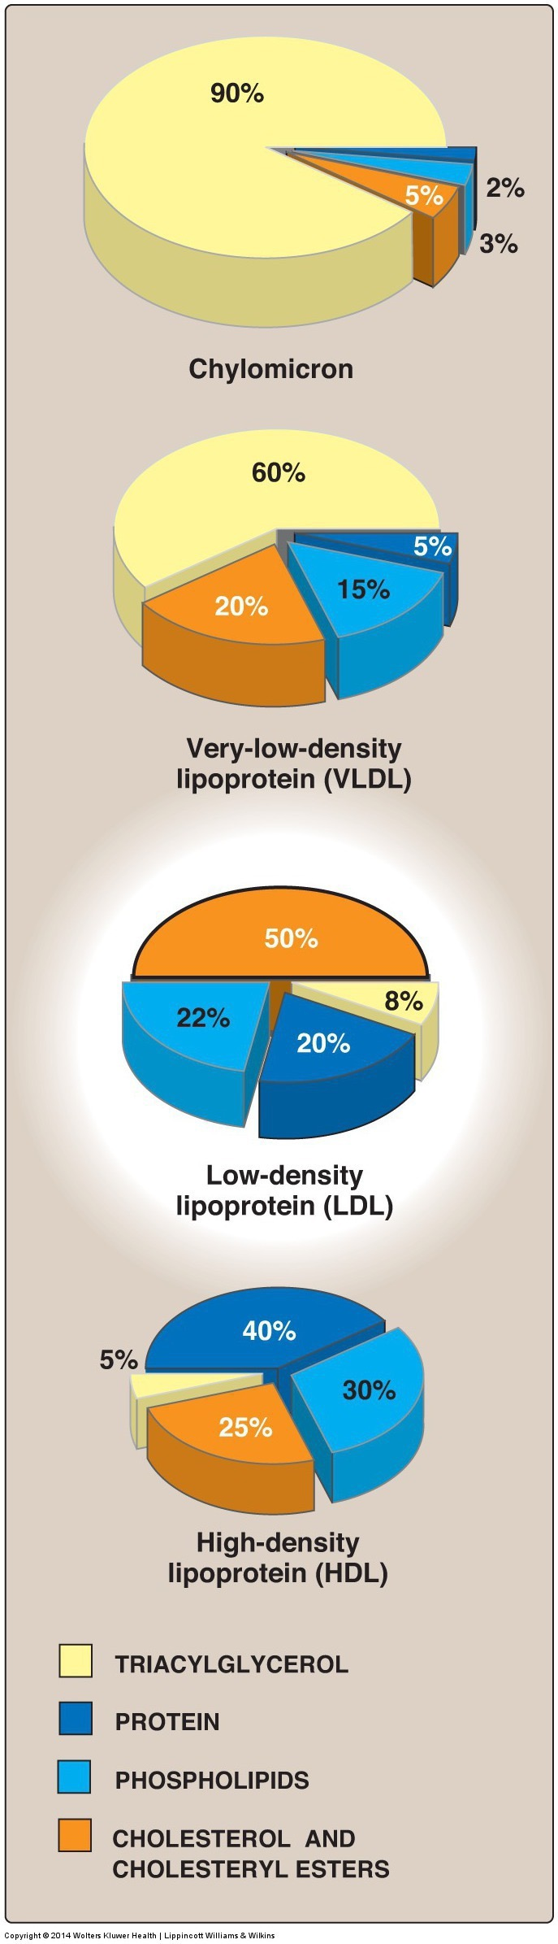
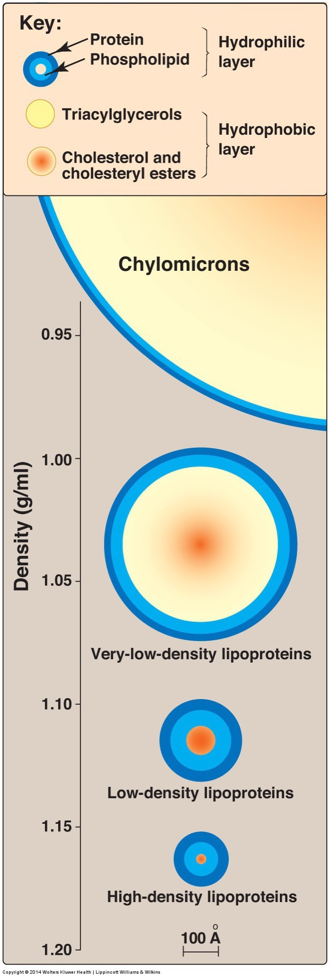
Lipoprotein Particles and Composition

Slide 4
Triglycerides from Chylomycrons and VLDL

Slide 5
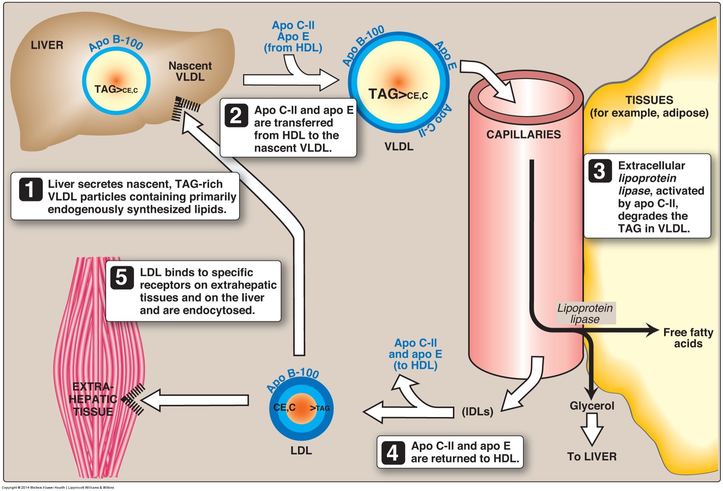
Production of VLDL by the Liver

Slide 6
Fatty Acids are Liberated from TG by Lipoprotein Lipase in Most Tissues
LPL highly expressed in heart, muscle, fat
Secreted by cells to ECM
Activated by Apolipoprotein on Chylomicron/VLDL (ApoCII)
Remaining particle (now IDL/LDL) is cholesterol rich and is taken up by the liver

Slide 7
Why Is this Important?
The liver is a poor storage tissue for lipids compared to adipose tissue
VLDL allows liver triglycerides to be moved to tissues for:
Storage (Adipose)
Oxidation (Muscle)
Defects would make lipids build up in the liver causing non-alcoholic fatty liver disease

